Slide 1


DevOps Habits and Practices
Brian Keyes
Azure Development Specialist

Slide 2
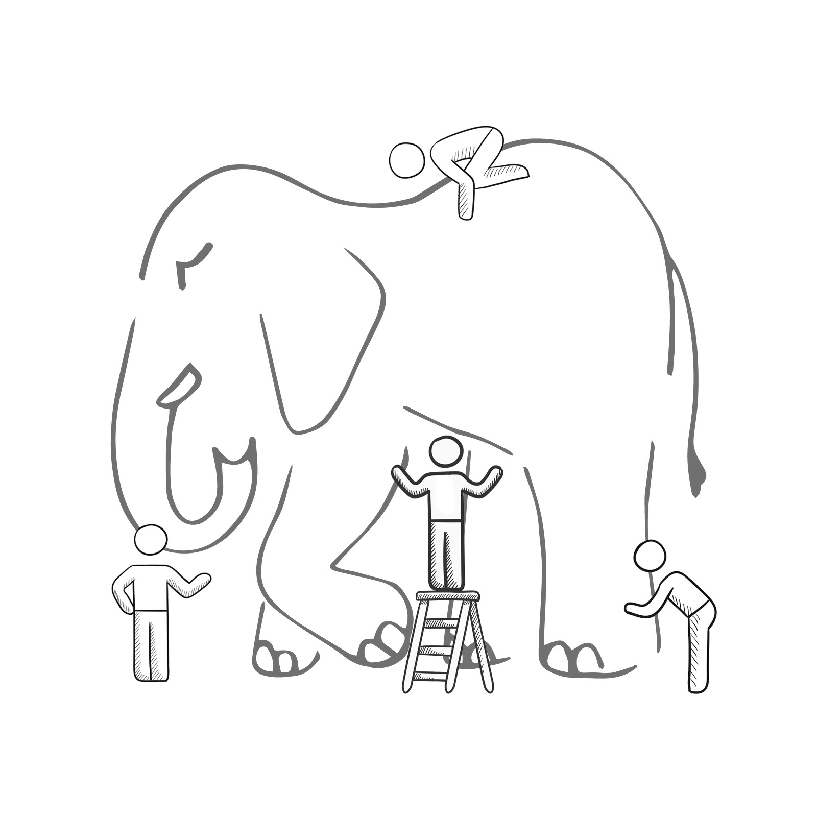
What is DevOps?
It’s a job title
It’s automation
It’s Development and Operations collaboration
It means faster and smaller releases
Notes:
It was – and still is - the time of Agile and DevOps.
We had to formulate a DevOps strategy for our entire organization.
But what is DevOps? It can mean radically different things for different people!

Slide 3
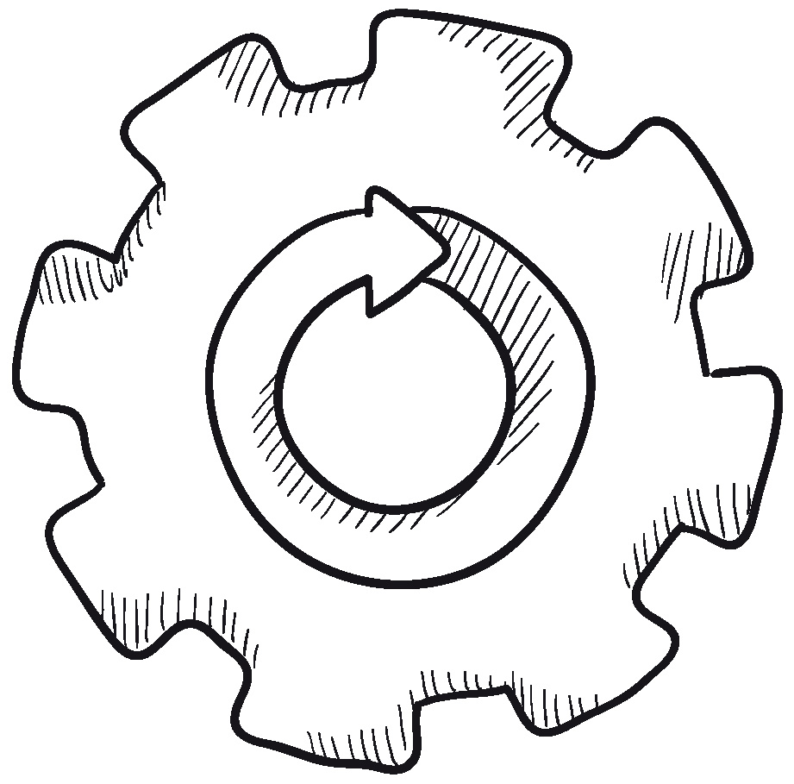
A converged lifecycle
Plan + Track
Release
Development
Production
Develop + Test
Monitor + Learn
Notes:
For us, DevOps means the merging of two previously isolated lifecycles – development and IT operations.
A converged DevOps lifecycle gives us the ability to execute on ideas quickly and iterate on feedback rapidly, with minimum friction.

Slide 4
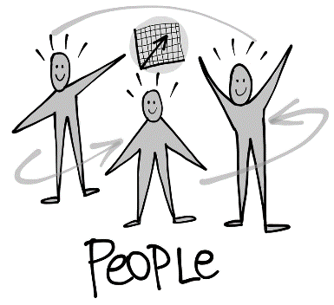
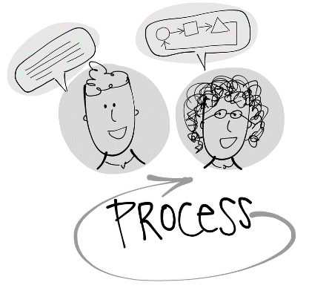
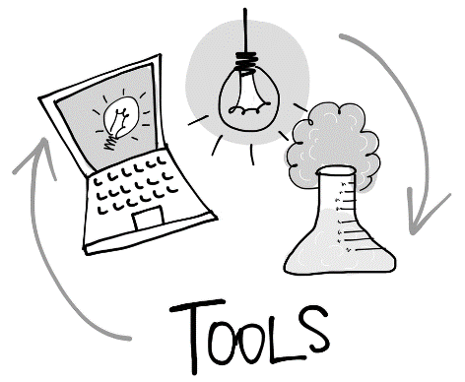
Collaborate more
Share common goals
Focus on improvement
BRINGING PEOPLE TOGETHER
PEOPLE
The DevOps conversation
Eliminate waste
Increase efficiency
Streamline feedback
DELIVERING VALUE FASTER
PROCESS
Enhance productivity
Enable collaboration
Facilitate experimentation
EXECUTING THE DEVOPS STRATEGY
TOOLS
Notes:
We quickly realized that our DevOps transformation will have broad organizational impact.
Every DevOps conversation needs to focus on people, processes and tools equally, otherwise the transformation will fail.

Slide 5

Our 7 DevOps habits
FLOW OF CUSTOMER VALUE
AUTONOMY and ALIGNMENT
BACKLOG improved by LEARNING
EVIDENCE gathered in PRODUCTION
MANAGED TECHNICAL DEBT
PRODUCTION FIRST MINDSET
INFRA as a FLEXIBLE RESOURCE
Notes:
Our DevOps journey began with the definition of seven DevOps habits, habits that we have refined over time.
DevOps habits are broad mindset changes that everybody in our organization has to actively embrace and live every day.
Let‘s look at them individually.

Slide 6
DevOps practices
Infrastructure as Code
Cloud Dev/Test
Automatic Scaling
Sandboxing/Dev and Test Labs
Containerization
Microservices Architecture
Automated Testing
Continuous Integration
Continuous Deployment
Release Management
Peer Code Reviews
Automated Testing
Continuous Measurement
Agile Documentation
Shift-Left into the Inner Loop
Usage Monitoring
Telemetry Collection Testing in Production
Stakeholder Feedback
FLOW OF CUSTOMER VALUE
AUTONOMY and ALIGNMENT
BACKLOG improved by LEARNING
EVIDENCE gathered in PRODUCTION
MANAGED TECHNICAL DEBT
PRODUCTION FIRST MINDSET
INFRA as a FLEXIBLE RESOURCE
Testing in Production
Usage Monitoring
User Telemetry
Stakeholder feedback
Feature flags
Experiments
Scaled Agile
Self-managing teams
Feature crews
Application Performance Management
Infrastructure as Code
Continuous Delivery
Release Management
Configuration Management
Automated Recovery
Notes:
Our DevOps journey began with the formulation of seven DevOps habits, refined over time.
DevOps habits are broad mindset changes that everybody in our organization has to actively embrace and live every day.
Let‘s look at them individually.

Slide 7





Flow of customer value
Notes:
Flow refers to an organization’s ability to move software from initial idea through creation and validation into the hands of customers and users, without impediments or rework loops.
Reduced rework allows teams to focus on delivering more value.
Shorter cycle times support increased responsiveness, in turn fostering customer and user satisfaction and trust.

Slide 8
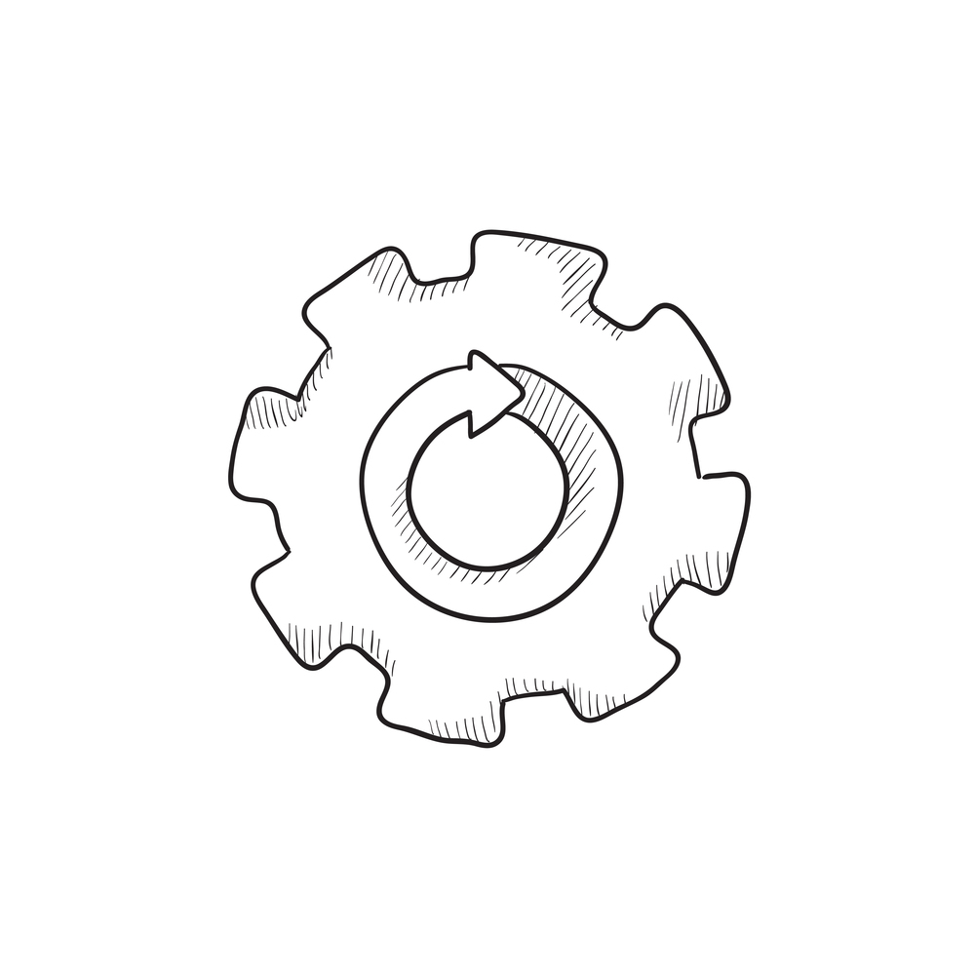
Improving flow of value
CONTINUOUS INTEGRATION CONTINUOUS DEPLOYMENT
RELEASE MANAGEMENT
AUTOMATED TESTING
Notes:
DevOps practices make DevOps habits actionable.
Our DevOps practices are well documented and can easily be implemented by individual teams.
Here are some of the practices that are related to improving flow of value.

Slide 9

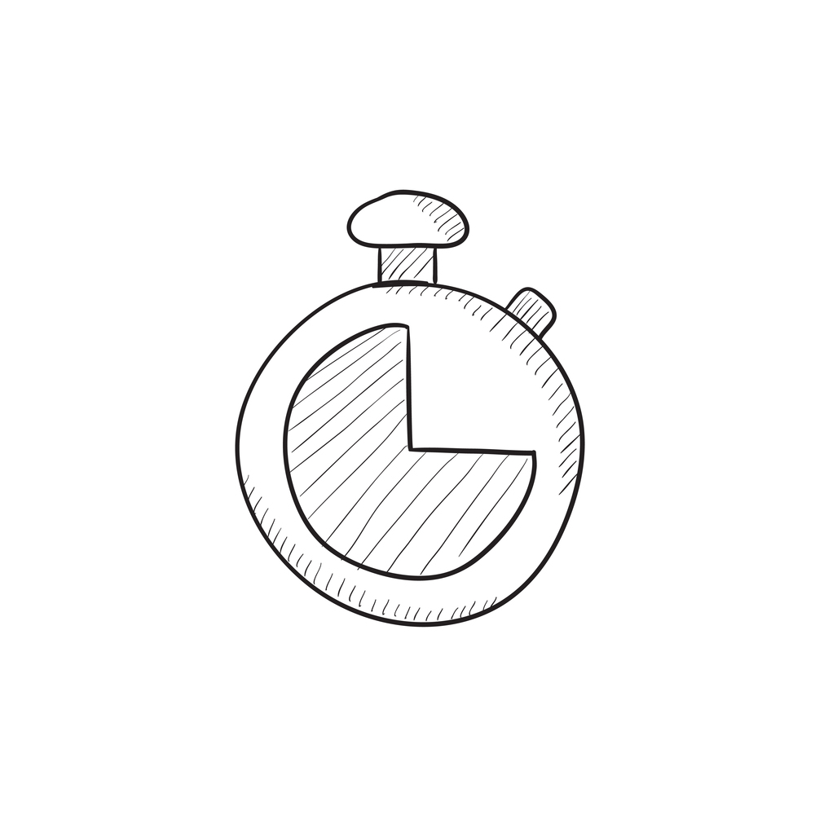
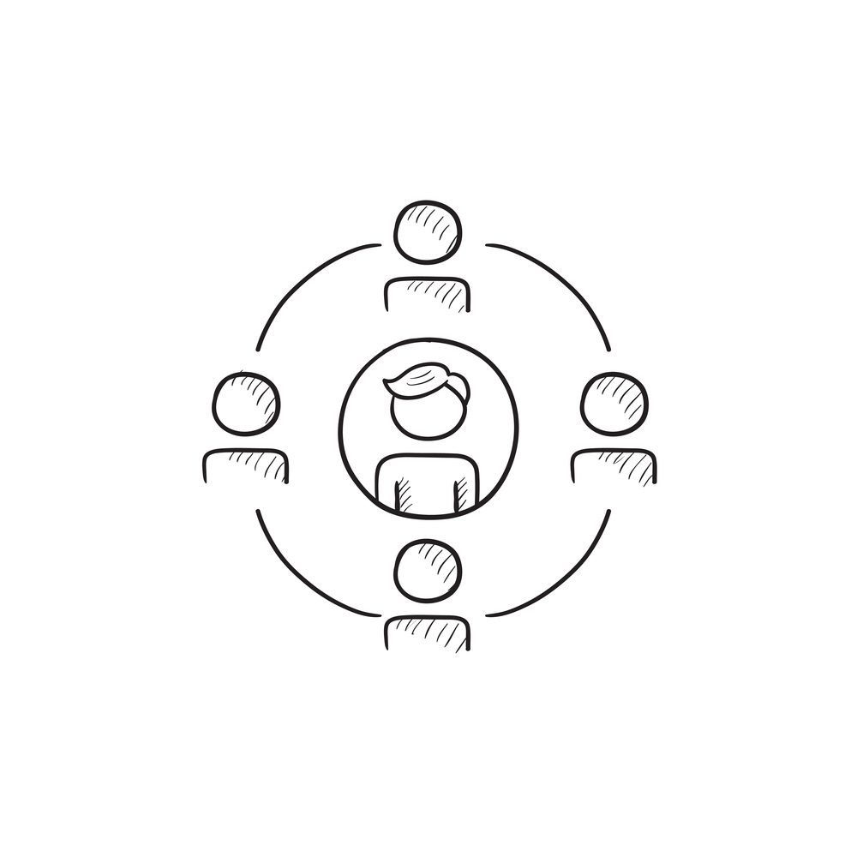
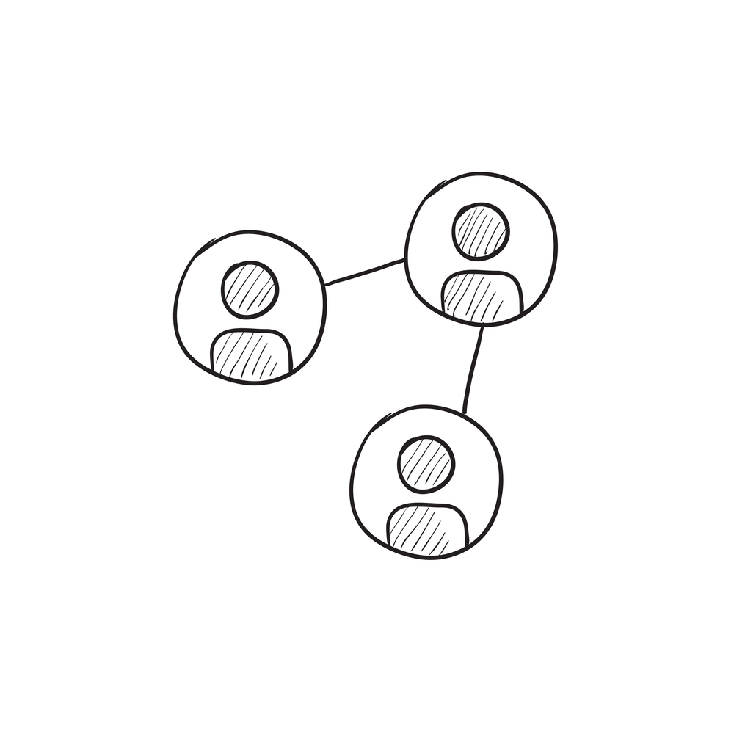
Team autonomy and alignment
Notes:
Our main goal is responsiveness.
Being responsive relies on flexible scheduling, short iterations, and close team collaboration.
This eliminates wasteful handoffs.
Each team has the freedom to self-organize their work with full autonomy.

Slide 10
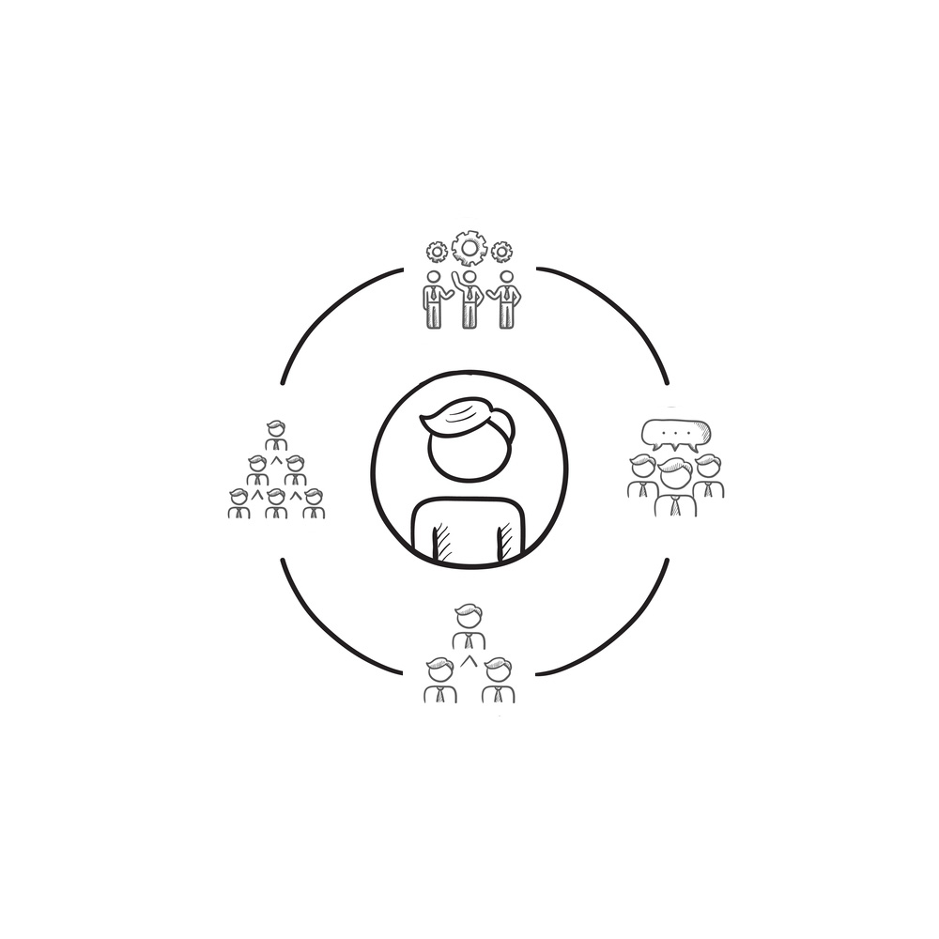
Increasing alignment and autonomy
SELF-MANAGING TEAMS
PLANNING CHATS
FEATURE CREWS
SPRINT RITUALS
SCALED AGILE
TEAM ROOMS
Notes:
We have multidisciplinary feature teams working from a common product backlog, delivering work ready to deploy at the end of each sprint.
We don‘t tell our teams how to do their work or what rituals to embrace, all that counts are results.

Slide 11
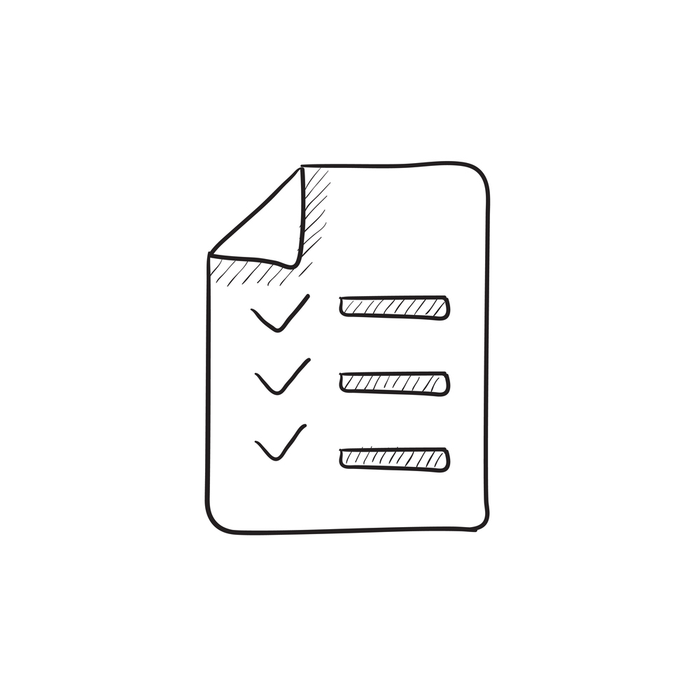




Backlog improved by learning
Notes:
We treat our backlog as a set of hypotheses, which are turned into experiments, and for which we collect data.
We also constantly engage with stakeholders and track their feedback.
Based on data and feedback we plan our next move and persevere or pivot.

Slide 12
Continuous improvement
USER TELEMETRY
USAGE MONITORING
STAKEHOLDER FEEDBACK A/B TESTING IN PRODUCTION
Notes:
We have implemented practices that help us collect information from different sources.
All of this information helps us continuously keep our backlog in sync with business goals and re-align with sudden changes in the environment.

Slide 13
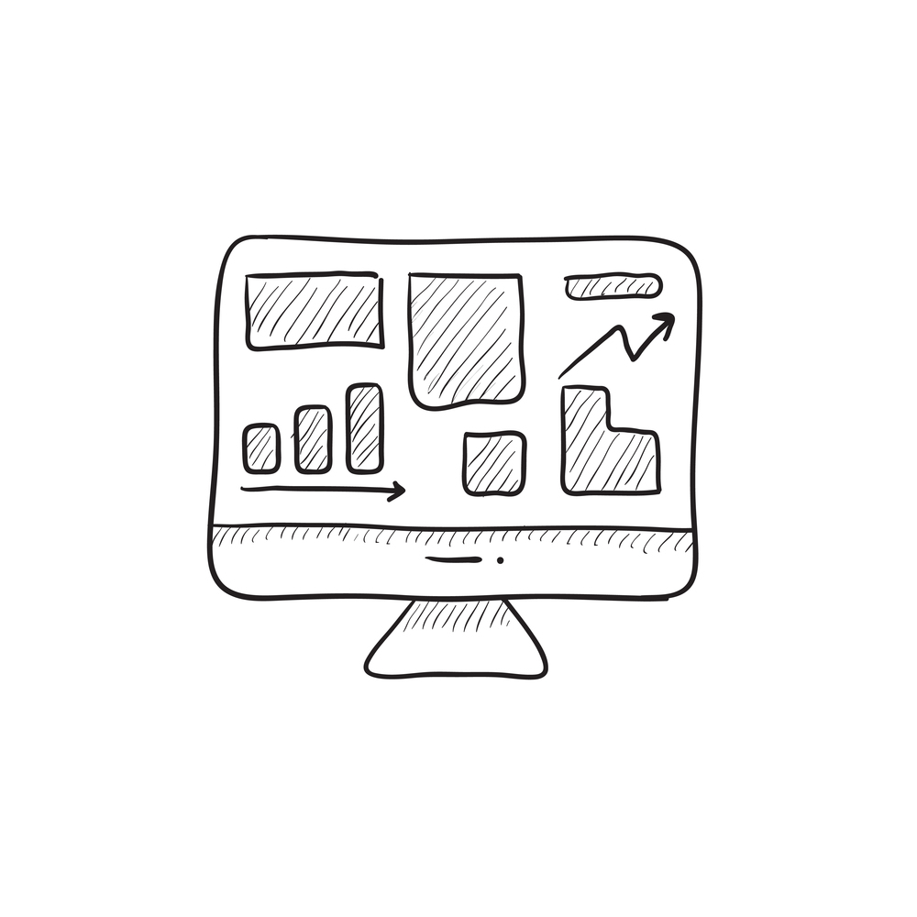
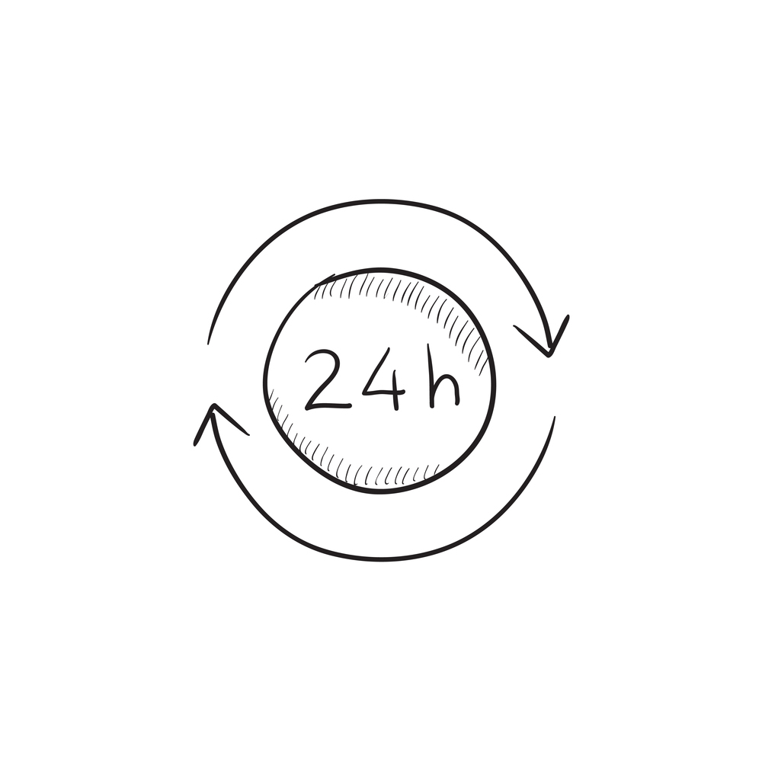


Evidence gathered in production
Notes:
Good experiments provide actionable data.
We measure everything - health, availability, performance, and other quality of service metrics, but also usage - to collect evidence that proves or disproves each backlog hypothesis.

Slide 14
Collecting evidence
TESTING IN PRODUCTION
STAKEHOLDER FEEDBACK
USAGE MONITORING
USER TELEMETRY
FEATURE FLAGS
Notes:
We rely heavily on experimentation to fine-tune our products and services.
At any point in time, we run hundreds of experiments in production.
We then contrast usage data among cohorts, for example weekday and weekend users, to hypothesize ways of improving the experience for each.

Slide 15
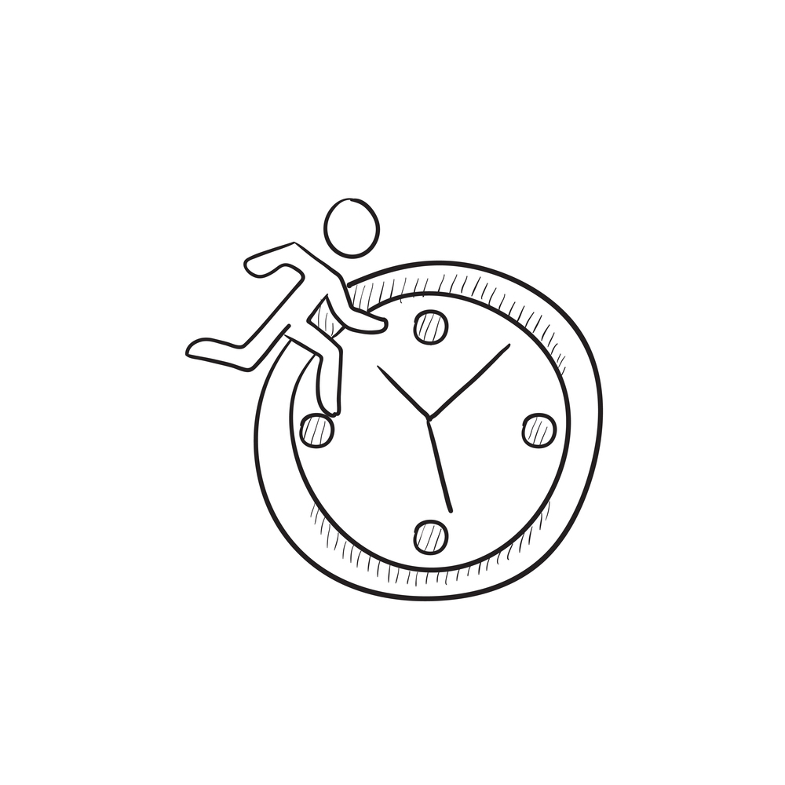



Managed technical debt
Notes:
Technical debt are problems that negatively impact flow and progress.
Technical debt lowers productivity, makes code fragile and causes bugs that create unplanned work.
We aim to zero out our technical debt in each sprint to limit long-term negative impact.

Slide 16

Lowering technical debt
SHIFT-LEFT
CODE METRICS
TEST AUTOMATION
PEER CODE REVIEWS
CONTINUOUS INTEGRATION
CONTINUOUS UNIT TESTING
Notes:
Keeping technical debt down starts with high-quality code.
We have implemented practices to increase code quality at an individual developer level.
After that, we rely heavily on test automation.
Every team has a goal of reducing technical debt to zero in each iteration.
Bug Jail

Slide 17



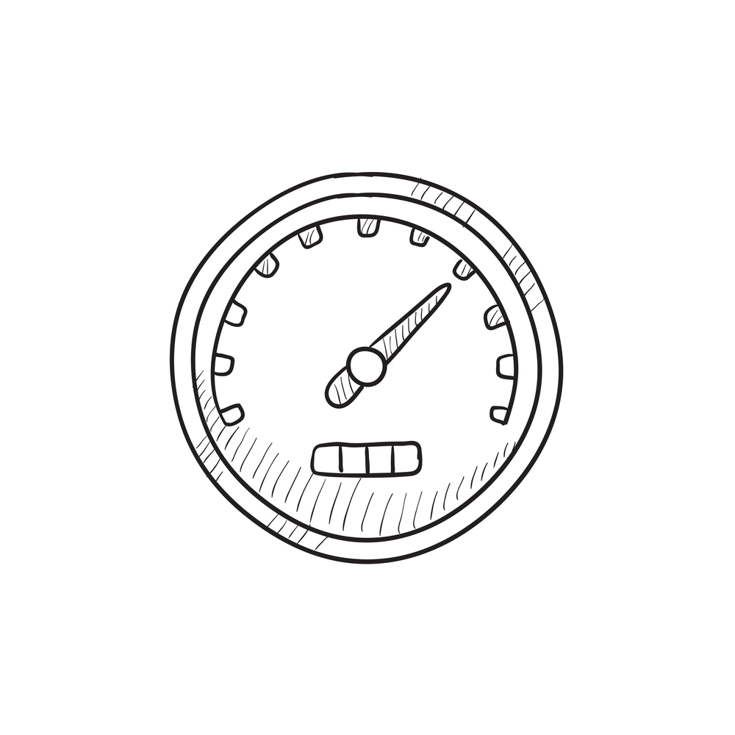
Production-first mindset
Notes:
Production lies at the heart of our software delivery organization. Uptime > new features
Production is every team member’s #1 job in every role, not just IT operations.
We continuously track live site status, immediately remediate any live site issues, and proactively identify outliers in performance.

Slide 18
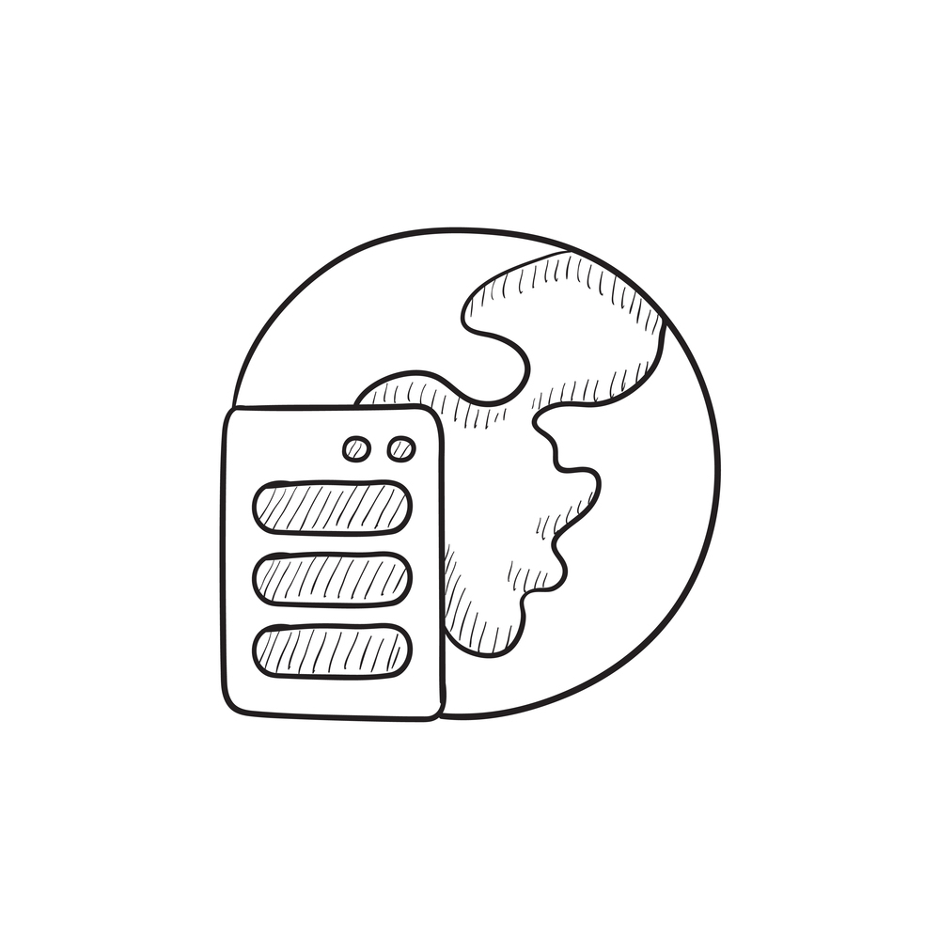
Putting production first
APPLICATION PERFORMANCE MANAGEMENT
CONFIGURATION MANAGEMENT
INFRASTRUCTURE AS CODE
AUTOMATED RECOVERY
CONTINUOUS DELIVERY
RELEASE MANAGEMENT
Notes:
We don‘t use pre-production environments, we deploy directly to production in each iteration.
We have implemented DevOps practices that enable us to recover quickly, facilitate root cause analysis of issues and an architecture that fails gracefully with minimum impact.

Slide 19

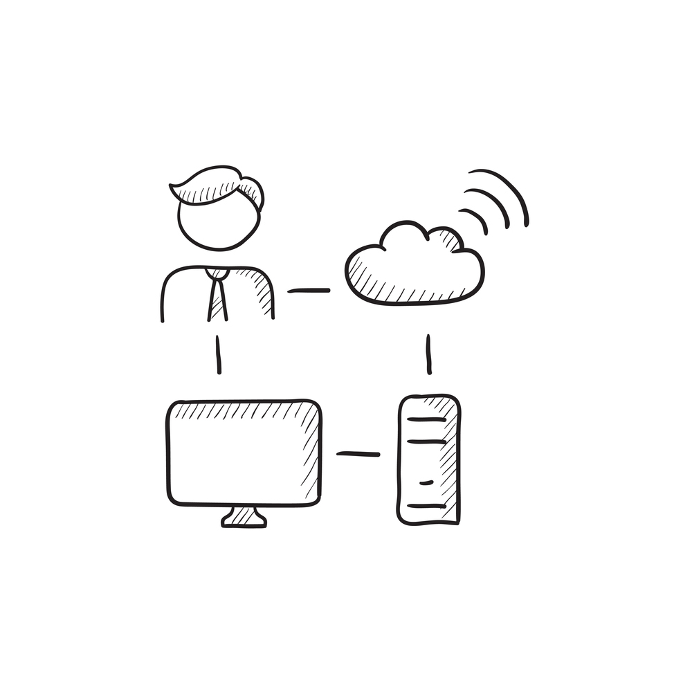
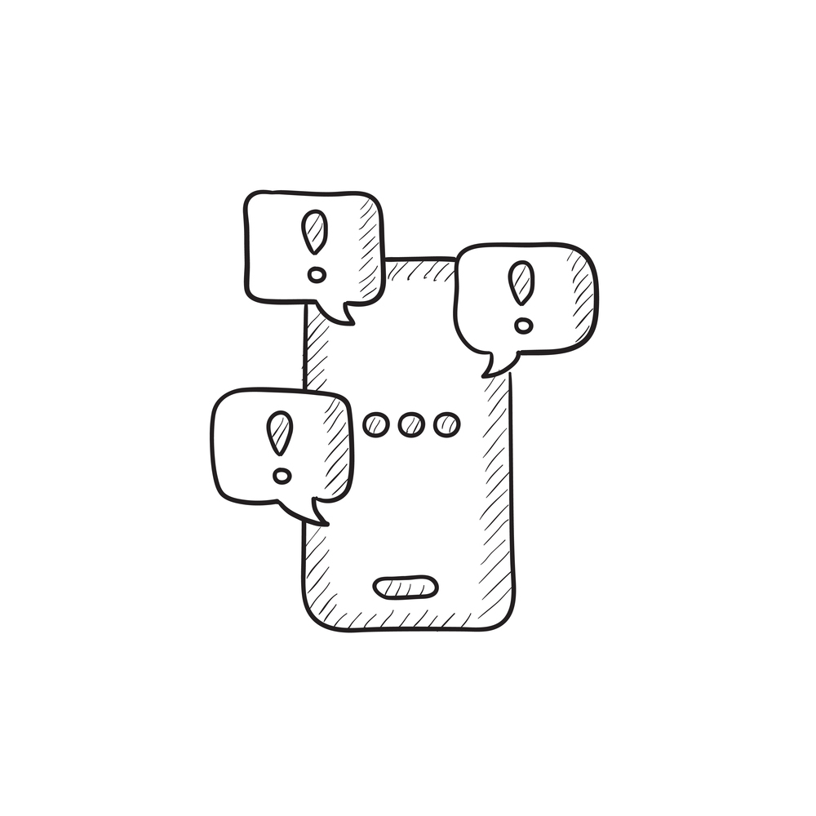
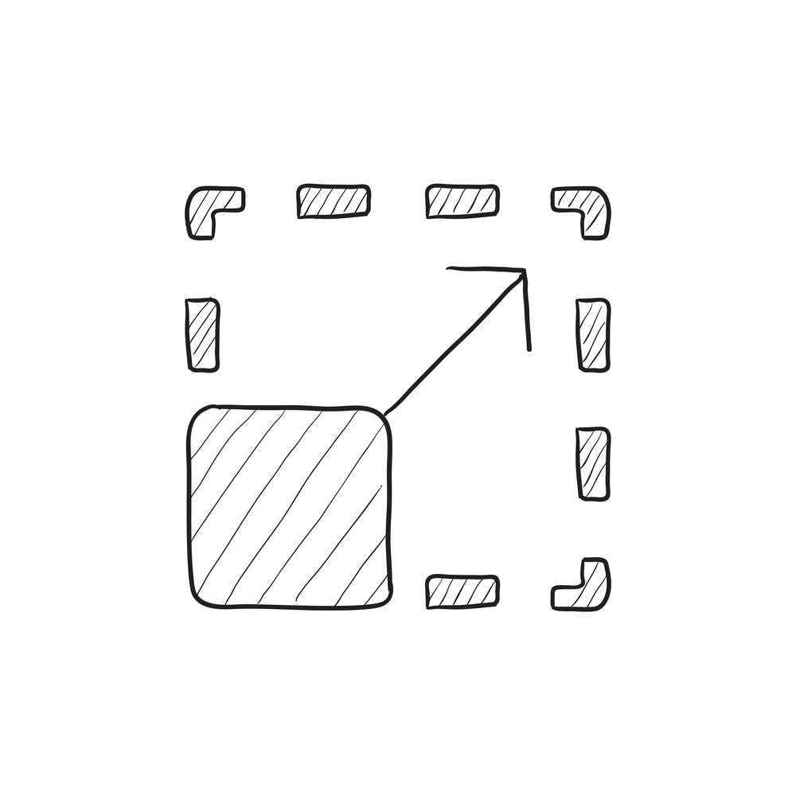
Infrastructure is a flexible resource
Notes:
We use the flexible infrastructure of the public cloud and continually improve our architecture to refactor into independent, discrete services.
Cloud infrastructure provides scale on demand and makes it easy to stand up services for continuous feedback from constant usage.

Slide 20
Flexible infrastructure
INFRASTRUCTURE AS CODE
DEVELOPER SANDBOXING
CLOUD DEV/TEST LABS
CONTAINERIZATION
MICROSERVICES
AUTOSCALING
FAILOVER
Notes:
Cloud infrastructure allows us to provision infinite resources on-demand, something that is impossible with traditional on-premises infrastrucuture.
This has enabled us to implement many innovative DevOps practices wit minimal capital outlay.

Slide 21
Shifting to DevOps
OLD WORLD
Focus on planning
Compete, not collaborate
Static hierarchies
Individual productivity
Efficiency of process
Assumptions, not data
NEW WORLD
Focus on delivering
Collaborate to win
Fluid and flexible teams
Collective value creation
Effectiveness of outcomes
Experiment, learn and respond
Notes:
Software development has changed – old prerogatives and priorities have shifted and every software delivery organization must address these changes in order to survive.
The question is not if it will hit you – the question is when.
Are you ready for DevOps?

